Slide 1
Railway Ticket Reservation System
Software Engineering – Requirement Engineering
Group 6

Slide 2
Group Members
Ch. Arsalan Ali Daim BSCS14068
H.M. Abdul Wajid BSCS14054
Azhar Ali BSCS14058
Danish Javed BSCS14028

Slide 3
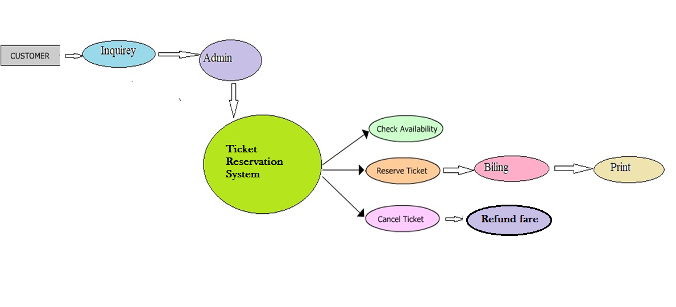
Abstract view of Software

Slide 4
Techniques
Ethnography
People come to buy ticket at the station and what is the procedure followed by the operator?
Use Case
Source → Destination → Available Train → Which Coach Passenger wants? → Amount of seat? → Issued
What if he wants to cancel?
Search Record → Found or not? → if yes, Cancel the booking → Record Deleted → Mark if amount is returned back to passenger?

Slide 5
Functional Requirements
Desktop Application
Operator should be able to:
Select the train
Search the vacancy of passengers in the train according to the coaches
Differentiate the coach of the train
Issue the ticket asked by the passenger
Enter amount given by the passenger
Cancel the ticket if the passenger ask to do so
And mark if he has returned the amount back to passenger
System should generate a unique identification No. for each passenger for differentiation
System should show total seats in the available trains
System should show the total amount at the end of each day

Slide 6
Non-Functional Requirements
Response Time should be less because it’s a real time application
It should be secure. Only operator can access the system by his account with code.
Easy to use and there should be no data redundancy
It effects good performance of the system
System shall give a good User Interface to easily see the Output

Slide 7
Metrices for Non-Functional Requirements
Speed
Response time for transections of data
Size
How much Mbytes it take to store each data by knowing how much bytes have given for a passenger
Ease of use
User Interface & understandability of operator
Reliability
Rate of failures when requested to save information

Slide 8
Requirements Validation
Consistency
There is no conflict with requirements
Realism
All the requirements can be achieved. Using C# Desktop Application will result us with all requirements
Verifiability Check
Prototypes
Test Case Generation

Slide 9
THANK YOU

